Slide 1
Crime Prediction (Law enforcement) using Artificial-Intelligence

Slide 2
TEAM MEMBERS
Tabish Javed 2017A7PS0151H
Dept: CS

Slide 3
INTRODUCTION

Slide 4


1. General Info.
Open Source Each and every tool is open source.
Reproducible
The entire model can be reproduced on any machine, on any platform. .
Scalable All the models and analysis are scalable to any amount of data provided.

Slide 5
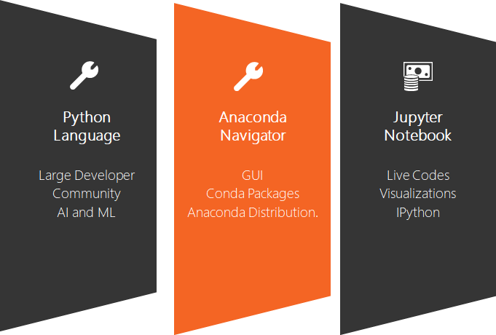
TOOLS USED

Slide 6
EVENTS ANALYSIS
An unstructured Dataset of type of crime & the respective feedback.
Cleaning up the dataset: Preprocessing the data and preparing it for analysis. This includes handling Null values, and bringing the data to the desired form.
EDA: Performing Exploratory Data Analysis.
Visualization: Visualizing the various aspects of the dataset, which gives us a better picture.
Then Crime Prediction based on the past trend and crime-pockets of a city.

Slide 7
EVENTS ANALYSIS

Slide 8
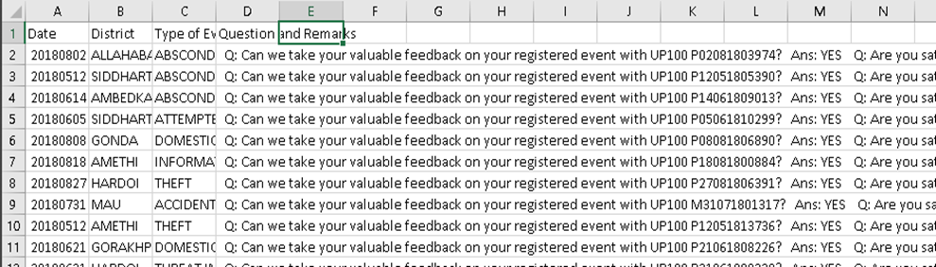
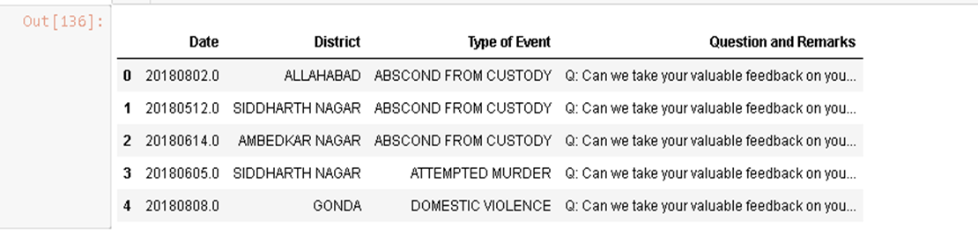
RECOMMENDATIONS
Dataframe

Slide 9
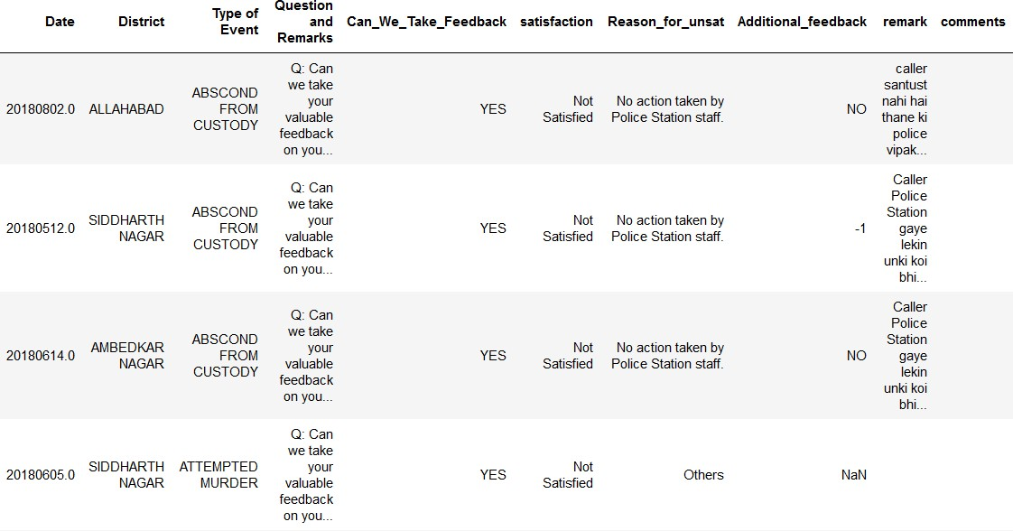
RE-STRUCTURING THE DATASET
Cleaning up the dataset: By iterating through the dataset row by row, and applying suitable string manipulations, the answer to each question is extracted and then put into its own column.

Slide 10
Exploratory Data Analysis & Data Visualization
Examine the data
Relationships b/w the variables
Identify potential problems
Spot patterns and Trends otherwise invisible in Excel
Descriptive and Graphical summaries

Slide 11
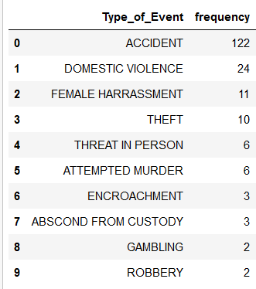
Crime Type
Accident | 122
Domestic Violence | 24
Female Harassment | 11
Theft | 10
Threat in Person | 6
Attempted Murder | 6
Total 19 crime types
Of these, the most reported cases were: Accident with 122 cases, Domestic Violence with 24, Female Harassment with 11

Slide 12
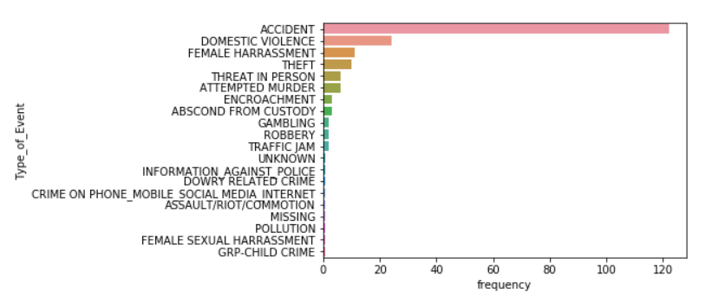

Slide 13
2. Heat-map
Agra | 8
Aligarh | 1
Allahabad | 9
Ambedkar Nagar | 3
Amethi | 3
A Geographical heat map leverages our geographical knowledge to represent approximate values.
Difficult to comprehend the data for 75 districts in tabular form.

Slide 14
What we used
Plotting with Geoplot and GeoPandas
Geoplot is a Python library providing a selection of easy-to-use geospatial visualizations
Geoplot can re-project data into any of the map projections.

Slide 15
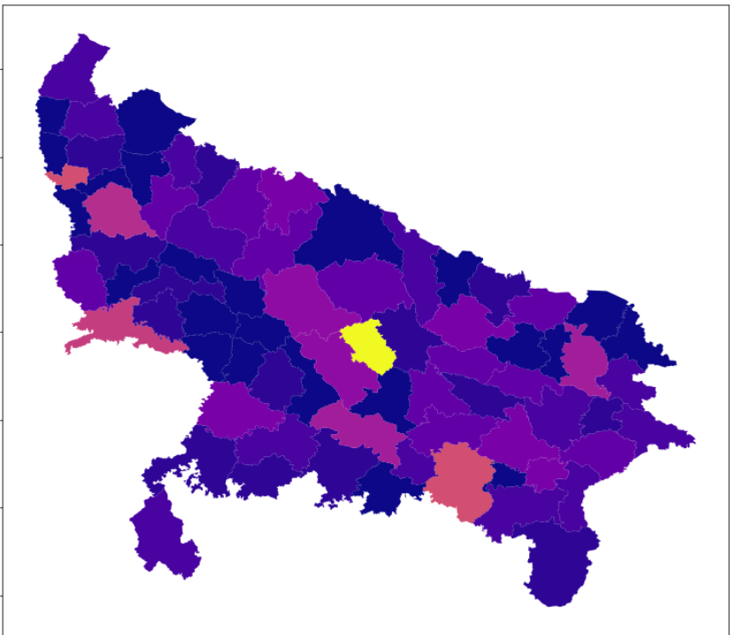


Slide 16
Lucknow is a hotspot, according to the data provided to us, with around 17 cases.
Followed by Kanpur with 13 cases.
The data seems to be skewed for Lucknow. As it is not normalized.

Slide 17
3. Day of the Week
Analyzed the the number of crimes taking place according to the day of the week.
Python provides us with excellent date time tools to manage Time based data.
We first change the date column to proper datetime format. Then using the datetime library, we extract the day of the week and find the total number of events by each day.

Slide 18
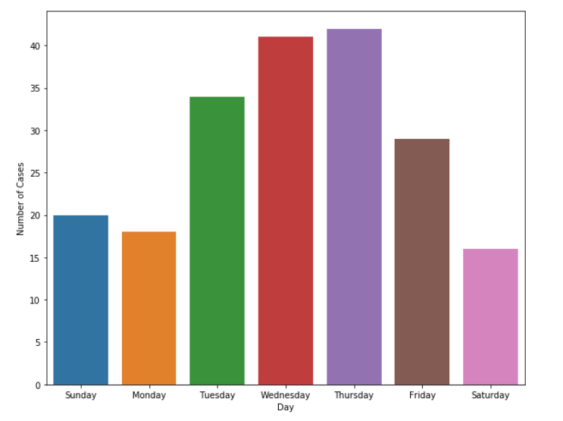
It is important to note that this visualization is based on the feedback data.
The feedback is collected, one day after the creation of an event.
By this logic, the days on which most cases are reported become Tuesday and Wednesday.

Slide 19
…
…

Slide 20
REFERENCES
All the data provided by Analysis and Research Centre, ITECCS, UP 100.
Python: https://www.python.org/
Anaconda: https://www.anaconda.com/
Jupyter: https://jupyter.org/
Numpy: https://www.numpy.org/
Pandas: https://pandas.pydata.org/
Matplotlib: https://matplotlib.org/
Seaborn: https://seaborn.pydata.org/
Plotly: https://plot.ly/
Dash: https://dash.plot.ly
The entire code can be found here:
https://github.com/TabishJaved77/Artificial-Intelligence-Project

Slide 21
Thank You

